Slide 1

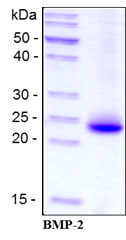
ReliaTech GmbH
Recombinant human BMP-2
(Cat# 200-001 / 200-002)
Figure 1: SDS-PAGE analysis of recombinant human BMP-2 produced in E. coli. Sample was loaded under reducing conditions in 15% SDS-polyacrylamide gel and stained with Coomassie blue.
http://www.reliatech.de / orders@reliatech.de

